Slide 1


TICKET BOOKING &
MOVIE RECOMMENDATION
TEAM K
VISHAL
YOKESHWARI
MUHAMMED RAZI K
AMAN JAZIM
FIZA NOOR K

Slide 2


INTRODUCTION
In the modern era, cinema is a major entertainment source.
Simulates theater seat booking, movie schedules, nearby theater search, and snack combo recommendations.
Built using Python, in-memory data structures (no database or file handling).
Interactive CLI-based menu for users.

Slide 3

OBJECTIVE
To create an efficient, interactive movie ticket booking system without file storage.
Demonstrate real-world problem solving using graph traversal, dynamic programming, and queue operations.
Ensure seat availability management, shortest path finding between theaters, and best combo suggestion based on budget.
Reduce booking time & queues.
Manual booking is time-consuming & inconvenient.

Slide 4

MATHEMATICAL CONCEPTS USED
Graph Theory → Representing theaters and connections.
BFS (Breadth-First Search) → Finding shortest path between theaters.
Dynamic Programming (0/1 Knapsack) → Selecting the best snack combos within budget.
Queue (FCFS) → Processing bookings in the order they are received.

Slide 5

EXPLAIN THE CONCEPTS IN DEPTH
Queue Data Structure
collections.deque used for First-Come, First-Served booking processing.
Prevents double booking and ensures fairness.
Graph Theory & BFS
Theaters are represented as nodes in a graph.
BFS algorithm finds shortest paths between two theaters.
Ensures minimum hops when searching for nearby theaters.
Dynamic Programming (Knapsack)
Snack combos are stored as (price, value) pairs.
0/1 Knapsack algorithm determines the maximum value within given budget.
Uses DP table and backtracking to reconstruct selected items.
Seat Management (Hash Map)
Seats stored as {seat_id: status} mapping.
Efficient lookups and updates for availability.

Slide 6

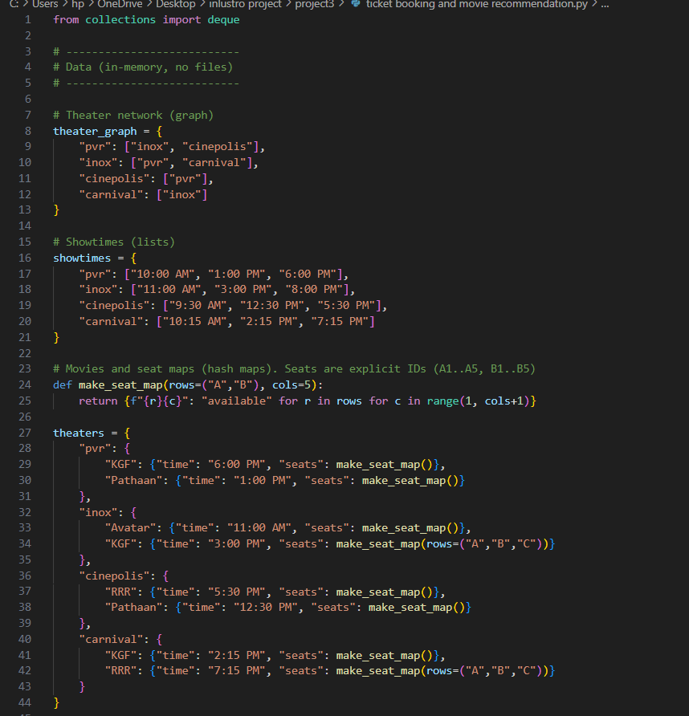
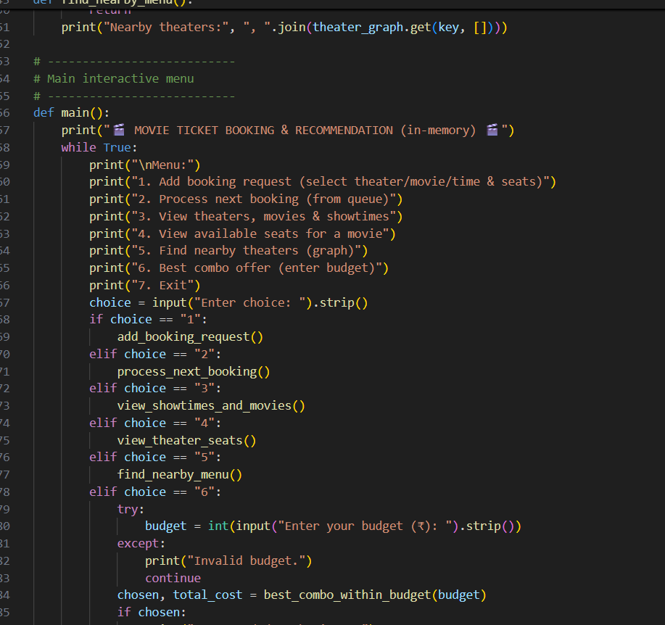
CODE

Slide 7
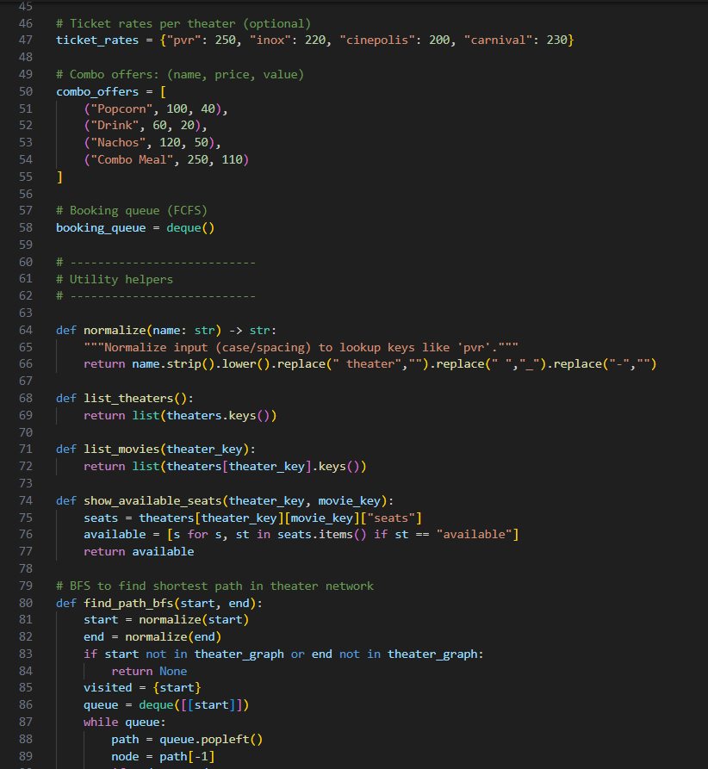
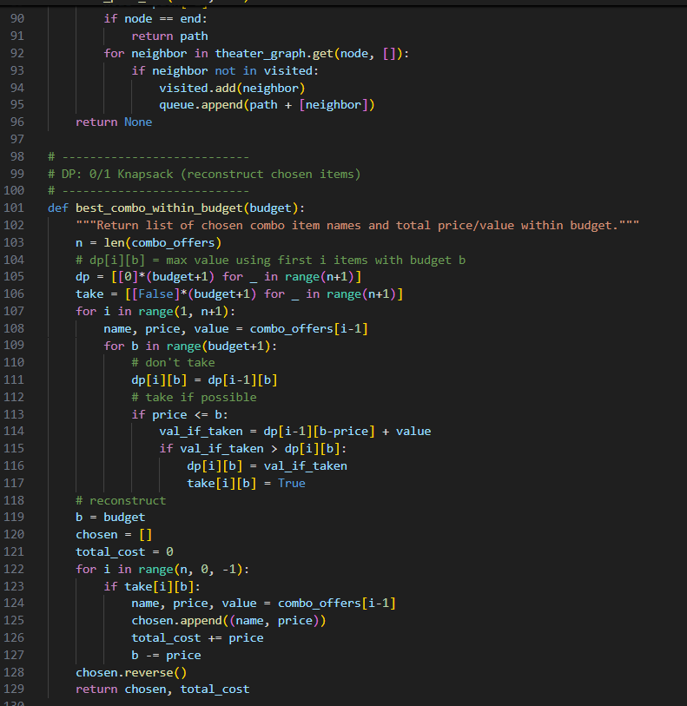

Slide 8
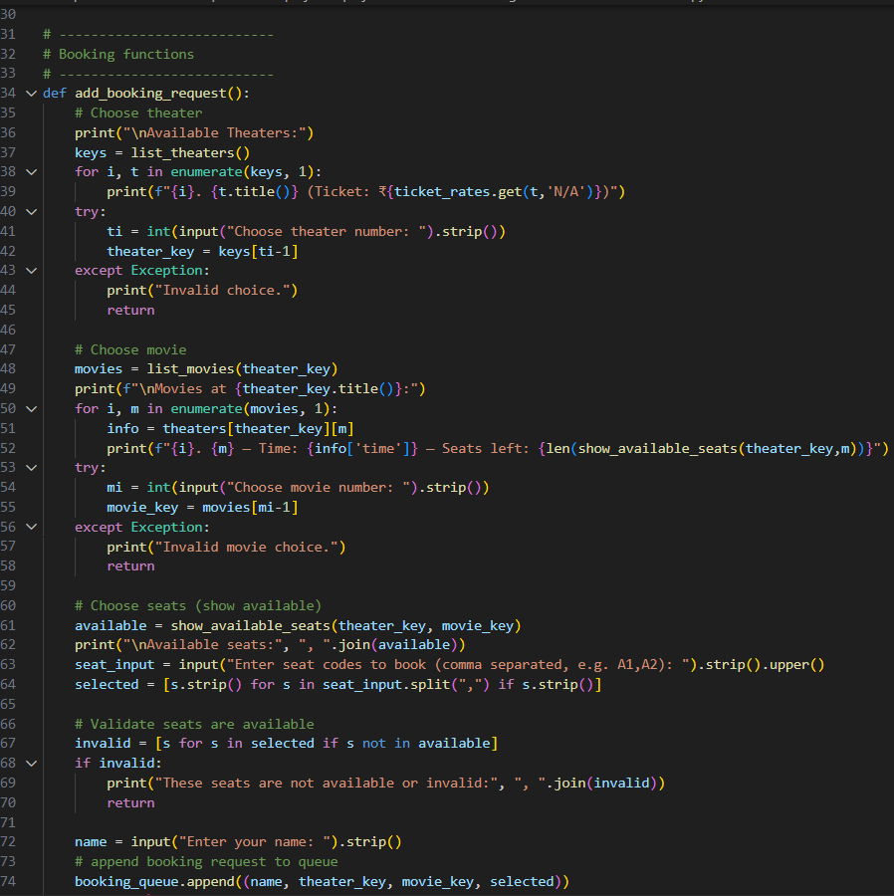
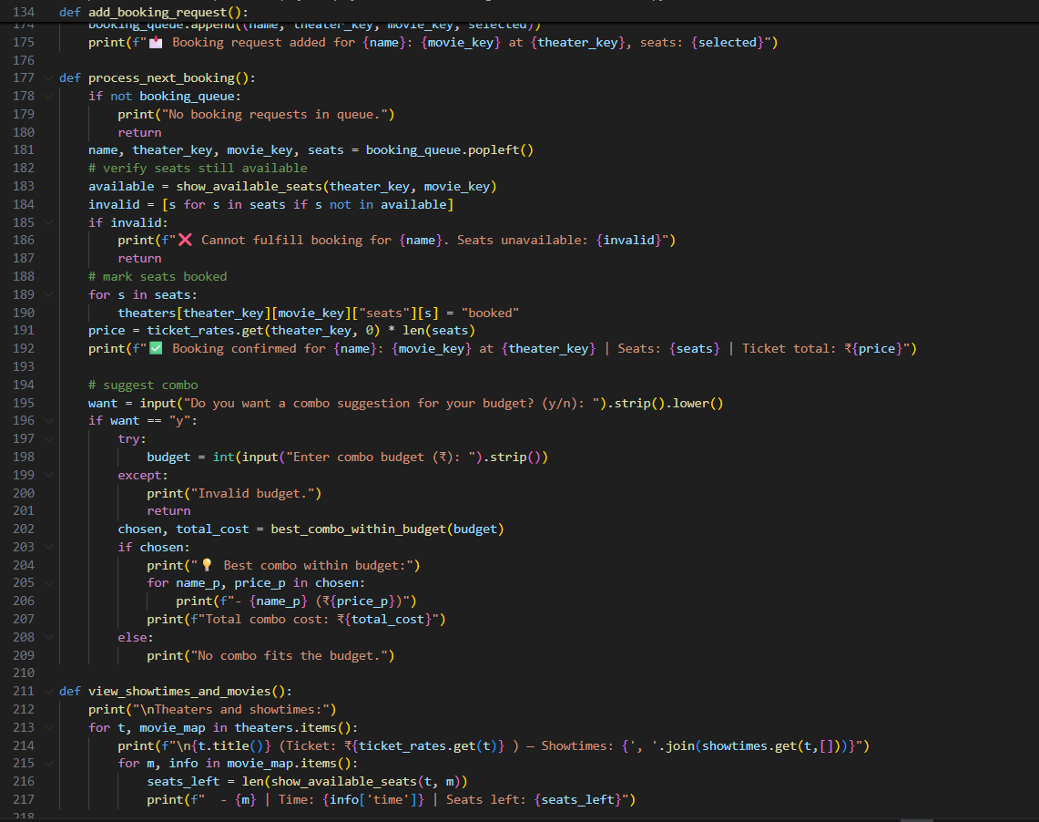

Slide 9
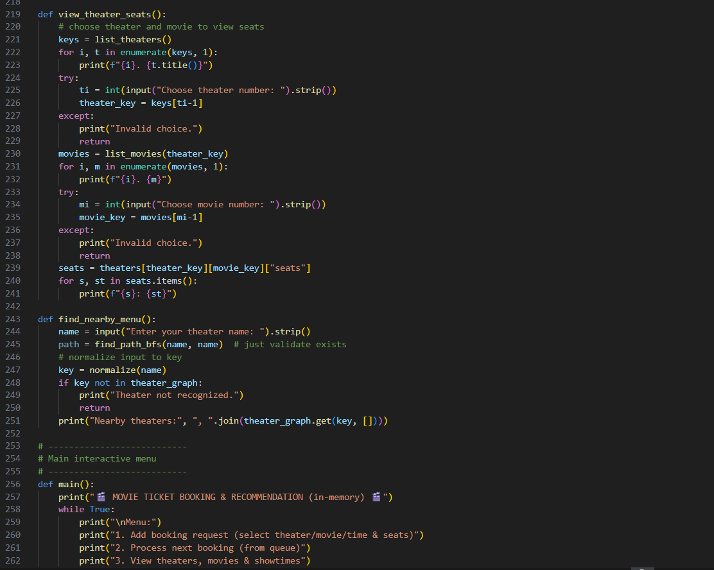
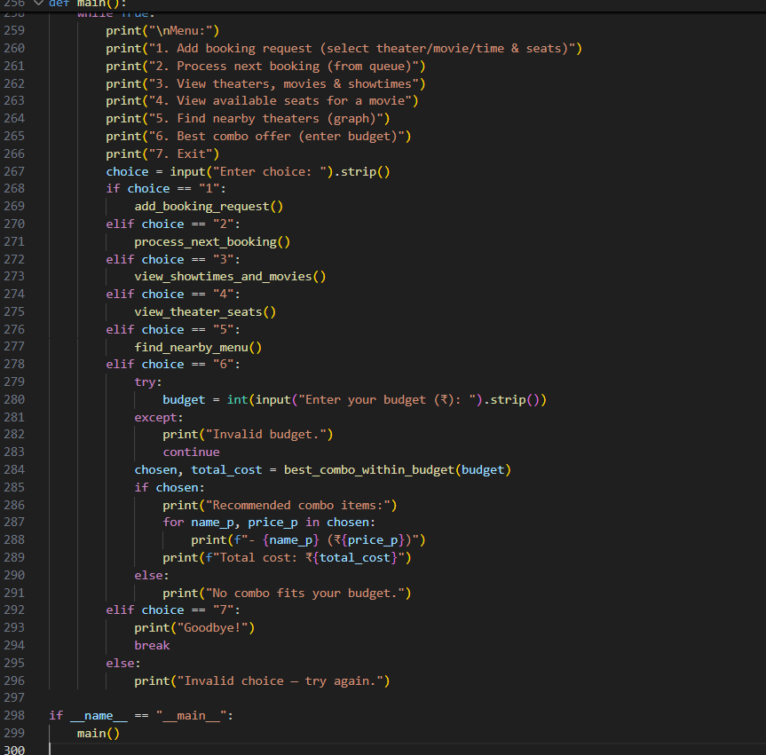
TICKET
TICKET

Slide 10
OUTPUT
&
SCREENSHOT
Sample outputs showing:
Adding a booking request.
Processing booking with seat confirmation.
Suggesting best snack combo for a given budget.
Displaying theaters, movies, and available seats.
Finding nearby theaters using BFS.
Screenshots of CLI interaction.

Slide 11
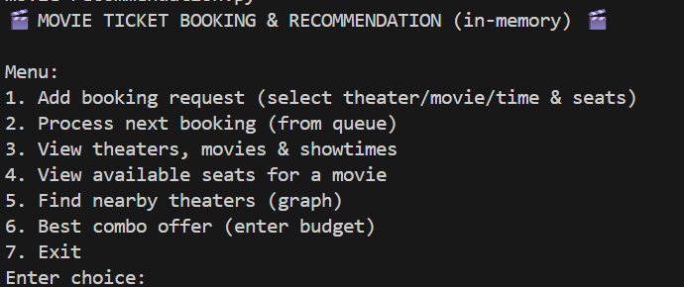

Slide 12

CONCLUSION
Successfully built a functional, in-memory movie booking system using Python.
Implemented real-world algorithms for booking, searching, and recommendation.
System demonstrates efficient data structure usage without databases.

Slide 13

THANK YOU
TEAM K

